Slide 1
Replit Teams for Education
Access these slides at:
https://bit.ly/3xzfaQr

Slide 2
Replit Teams for Education
Michael DiRamio michael.diramio@dsbn.org District School Board of Niagara

Slide 3
My Background with Replit
Started using Replit Classroom in March 2020
Needed to move from Netbeans to a web-based IDE that would work on chromebooks
Moved to Teams for Education when they shut down Classroom in Fall 2020
Part of a writing team in DSBN to develop programming tasks for Java and Python with automated test cases

Slide 4
Replit Overview
https://replit.com/
Online programming environment
Support for many languages
Free and Paid Accounts
Will be focusing on the Teams for Education features

Slide 5
Pros/Cons
Pros | Cons
No need to transfer code between devices or have students install IDEs at home Collaborative Programming Teacher can view students projects/leave feedback Simple Submission | Can be slow - especially with graphics If server is down, the whole class stops Must pay for Teams features Still a work in progress

Slide 6
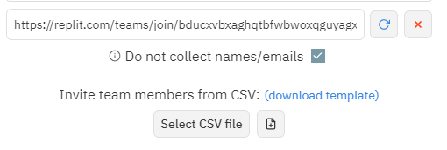
Join a Team
Join this team to see what it looks like from a student view: https://replit.com/teams/join/bducxvbxaghqtbfwbwoxqguyagxymjku-CEMC2021Presentation
Can set up invites to not collect names/emails

Slide 7
Resetting a Student Password
Because accounts are not associated with an email address, students cannot reset their passwords
Notes:
Show example

Slide 8
Replit Teams for Education
Not Free
$35 USD / month / team
Our board was able to negotiate a board-wide, unlimited license
Key Features
Team Repls - class wide project
Team Projects - each student has an individual copy
Can assign students to groups, with each group having a copy of the project
Automated test cases
Collaborative Coding/Live Access of Student Projects
Can leave notes (“threads”) in student code
Summary page to see who has submitted, passed test cases, etc
Continuing development - new features came in during the year

Slide 9
Team Repls
Everyone in the Team has access to one copy of the code and can edit it collaboratively
I didn’t find a good use for this with my class

Slide 10
Team Projects
Teacher creates a template for the project
Students each get an individual copy to work on
Can be set up so students are in groups, with each group having one copy
I used these in several ways
Lessons - develop code as a class and then students can each make a copy to play with
Small Tasks - with automated test cases
Larger assignments/projects - evaluated manually

Slide 11
Collaborative Programming and Threads
Multiple people can type in a project at the same time (similar to Google Docs)
Very handy when helping a student resolve an issue in their code
Threads are notes attached to parts of the code
Can mention a particular person with “@”
Notes:
Show example with two accounts

Slide 12
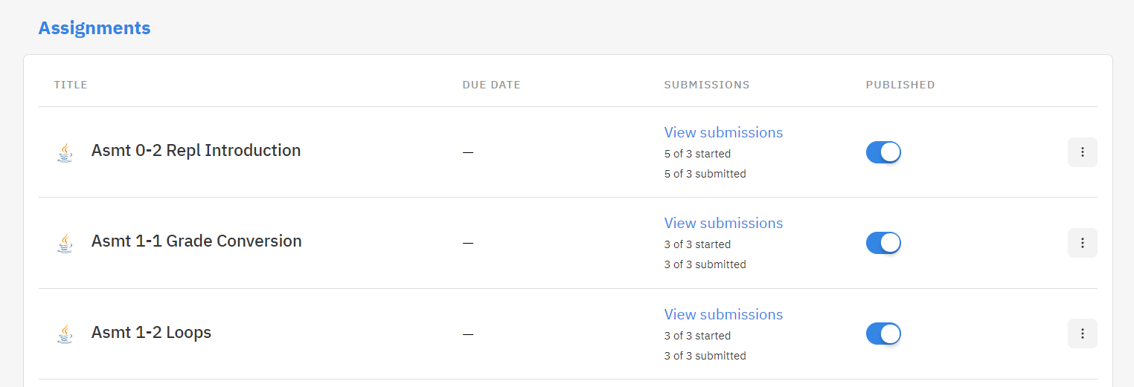
Naming Conventions for Group Projects
By naming the projects in a particular way, they will be grouped under headings. Only the project name will show up for students. Order can be used to force the projects into a particular order in that section.
Templates: group/order/project or group/project
Example: “Assignments/A1-1/Asmt 1-1 Grade Conversion”
Notes:
Example: Create “Examples/E-1/UnitTestExample2”

Slide 13
Projects Overview
Quick way to see the progress of the entire class
Shows the results of automated test cases
Notes:
Example: Show page

Slide 14
Submission and Feedback
Button in top-right corner for students to submit
Just a flag so the teacher knows that they are ready to be marked
Teacher can “unsubmit” a project
Feedback can only be made as Thread bubbles on code
Teacher marks as reviewed
Flag for the teacher, not seen by the student
Colour coding in Projects Overview and Navigation tab to show the stage each student is at with the project
Notes:
Example: Evaluate a project

Slide 15
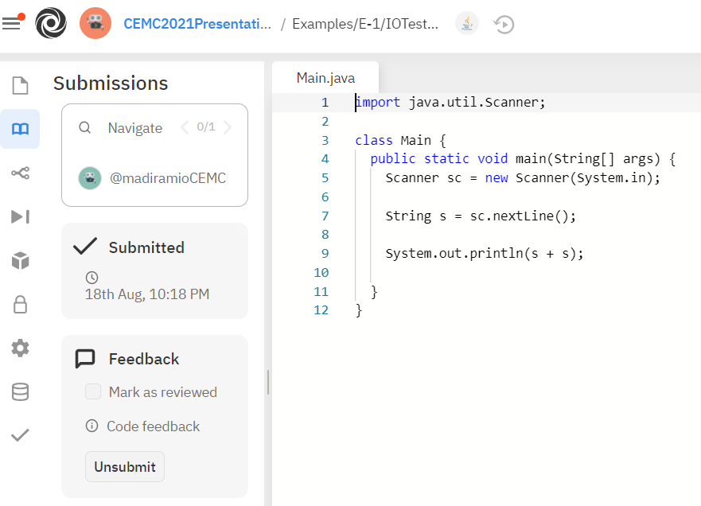
Teams Evaluation Page
Navigate Field to quickly switch between students
Colour coding to tell each student’s progress

Slide 16
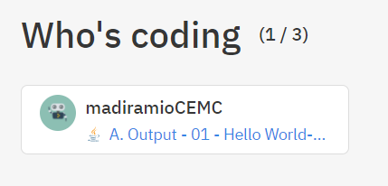
Who’s Coding
You can quickly see which students are actively working and what they are working on at the top of the Team mainpage
Notes:
Example: Show Page

Slide 17
Embedding Instructions
If you want to embed instructions in your projects, you can use README files.
They have added support for Markdown files
README.md
Cheatsheet: https://www.markdownguide.org/cheat-sheet/
Notes:
Example: Add a thread to a project

Slide 18
Automated Test Cases in Projects
Two styles of test cases
Input/Output
students read input from standard input stream and their output needs to match an expected output
there is an option for “close” matching but we found it difficult to use (accepted answers like “0” when “10” was expected
Unit Testing
calls methods coded by the student and compares the return values to an expected value

Slide 19
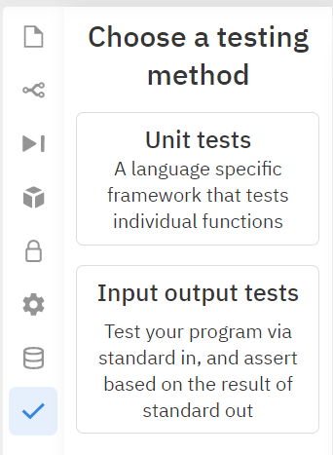
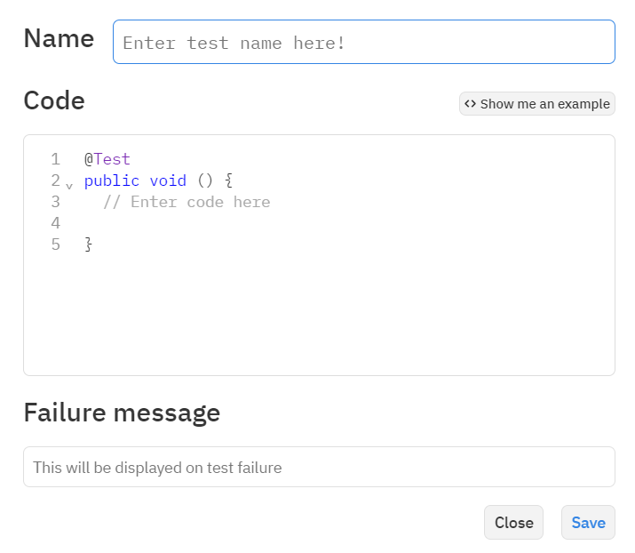
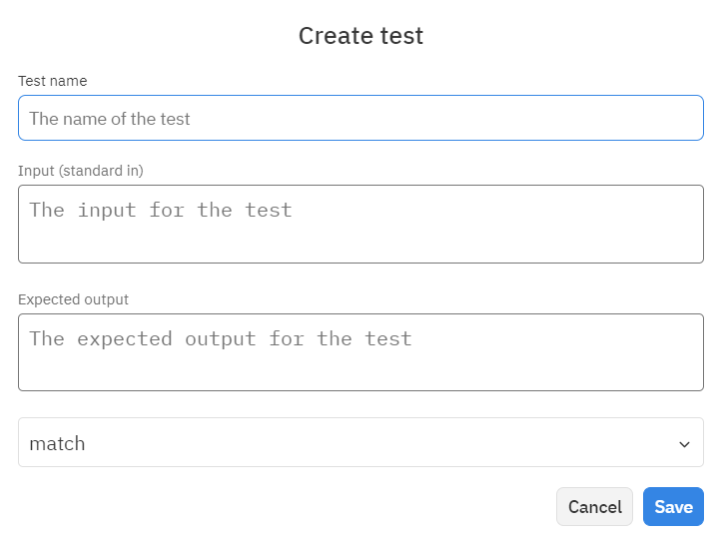
Notes:
Examples: - finish Examples/E-1/IOTestExample2 (sum of two numbers) USE EXACT
- create Examples/E-2/UnitTestExample2 (max)

Slide 20
Customizing the Run Button
You can create a file named “.replit” which overrides the default functionality of the run button
Referencing an uploaded library
Changing to another programming language
Example: See Lsn 2-1 Intro to Graphics
Uses an uploaded jar for graphics

Slide 21
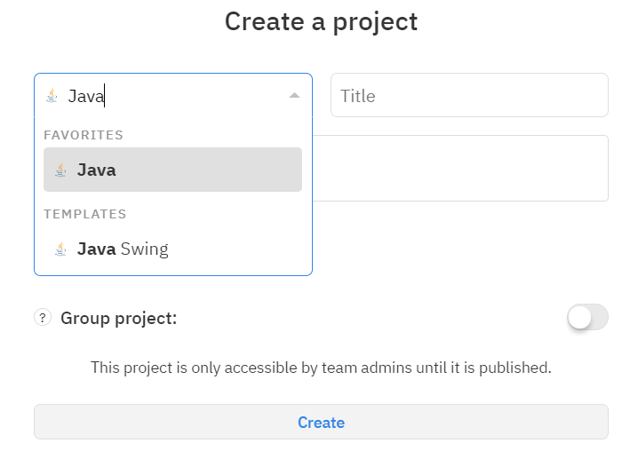
Using Graphics
Can be slow
Separate template for Text-Based and Graphical Projects
Successfully made Pong and a WarioWare-Style Game

Slide 22
Group Projects
Can set up a Project so a group of students all work on one copy collaboratively
Options to set up
Teacher assigns students to groups
Students self-group (new feature)
Notes:
Create “Examples/E-3/GroupExample”
Set to self-assign and see what happens!

Slide 23
Copying/Sharing Projects to Other Teams
Create a share link from the Team containing the projects
Need to select the Projects to be shared
Go to the generated URL
Select the Team you want to copy them to
Select which projects you want to copy
This can take some time to complete

Slide 24
Version Control Integration
Played with GitHub integration with my grade 12s with some success
Didn’t work within the Teams for Education
When they cloned the repository, it created a separate repl in their personal space
Students were able to branch, commit but I could not access their live code without them sharing their project with me

Slide 25
Troubleshooting
Refresh!
Status Page: https://status.replit.com/
Social Media - very active/responsive on Twitter and Facebook
Facebook Group “Replit for CS Education”
Community Page: https://community.replit.com/

Slide 26
Links to Automarked Tasks
Tasks developed by DSBN Computer Studies teachers:
Python
https://replit.com/teams/import/czthswlpenavtico-DSBNPython
Java
https://replit.com/teams/import/bgcqqpuhoxjdcwwc-DSBNJava

